Slide 1

Adversarial attacks on Machine Learning Algorithms.
Henil Vedant
495670888

Slide 2
Content
Problem Statement
Introduction & Motivation
Literature Review
Existing Attacks
Implemented Attack
Experimental Setup & Ananlysis
Results, Inference and Comments
Intuitive Defensive Strategy
Conclusion

Slide 3
Problem Statement: (Security & Privacy Perspective)
ML algorithms have an implicit nature which causes bias in the algorithms that leads to a vulnerability that compromises the security of system.
The following slides build on this property and demonstrates the implementation of an adversarial attack and its effects on the system.

Slide 4
Introduction
What are Adversarial attacks on ML models:
Adversarial attacks is a machine learning approach that aims to trick machine learning models by providing deceptive input.
The generation and detection of adversarial examples, which are inputs are often specially created to deceive classifiers^{.[1][2][3]}

Slide 5
Types of Adversary attacks (White and Black Box):
A white box attack is a scenario where the attacker has complete access to the target model, including the model’s architecture and its parameters^{.[2][4][5]}
A black box attack is a scenario where an attacker has no access to the model and can only observe the outputs of the targeted model.

Slide 6
Introduction
Basic idea of image classification: (CNN)
CNNs take advantage of the fact that, in any given image, proximity is strongly correlated with similarity.
This means that the two pixels that are near one another are more likely to be related compared to two pixels that are further apart, Whereas in a typical neural network, every pixel is connected to each neuron.

Slide 7
There are a large variety of different adversarial attacks that can be used against machine learning systems. Many of these work on deep learning systems and traditional machine learning models such as Support Vector Machines (SVMs) and linear regression.
Most adversarial attacks usually aim to deteriorate the performance of classifiers on specific tasks, essentially to “fool” the machine learning algorithm^{.[5][8]}
Adversarial machine learning is the field that studies a class of attacks that aims to deteriorate the performance of classifiers on specific tasks.

Slide 8
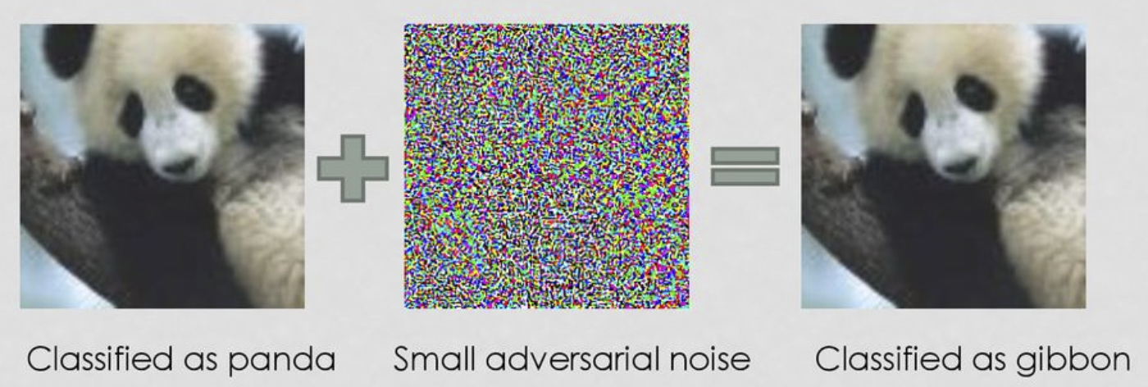
Adversarial attacks (L.R)

Slide 9
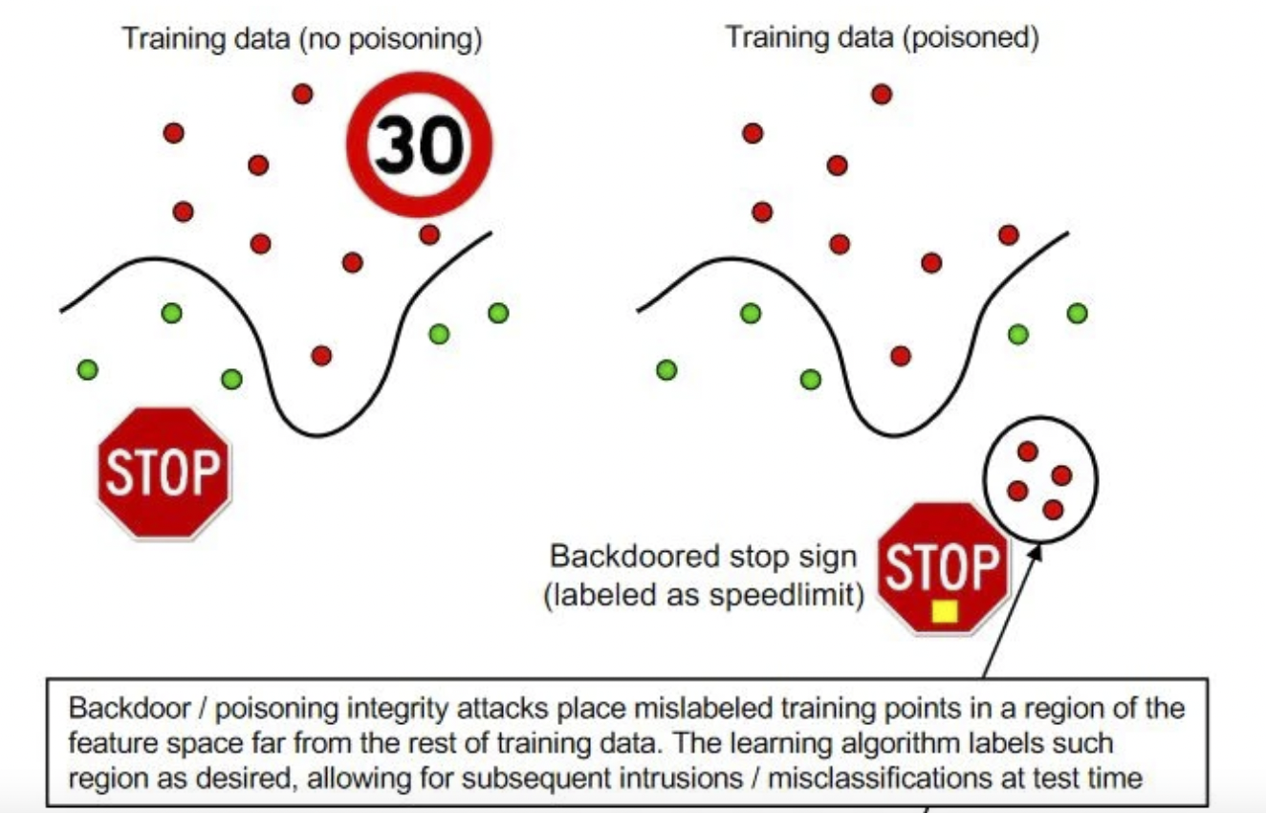
Why are Adversarial Attacks dangerous and how would they affect systems: ( Let’s go back to lecture 1 day 1).

Slide 10
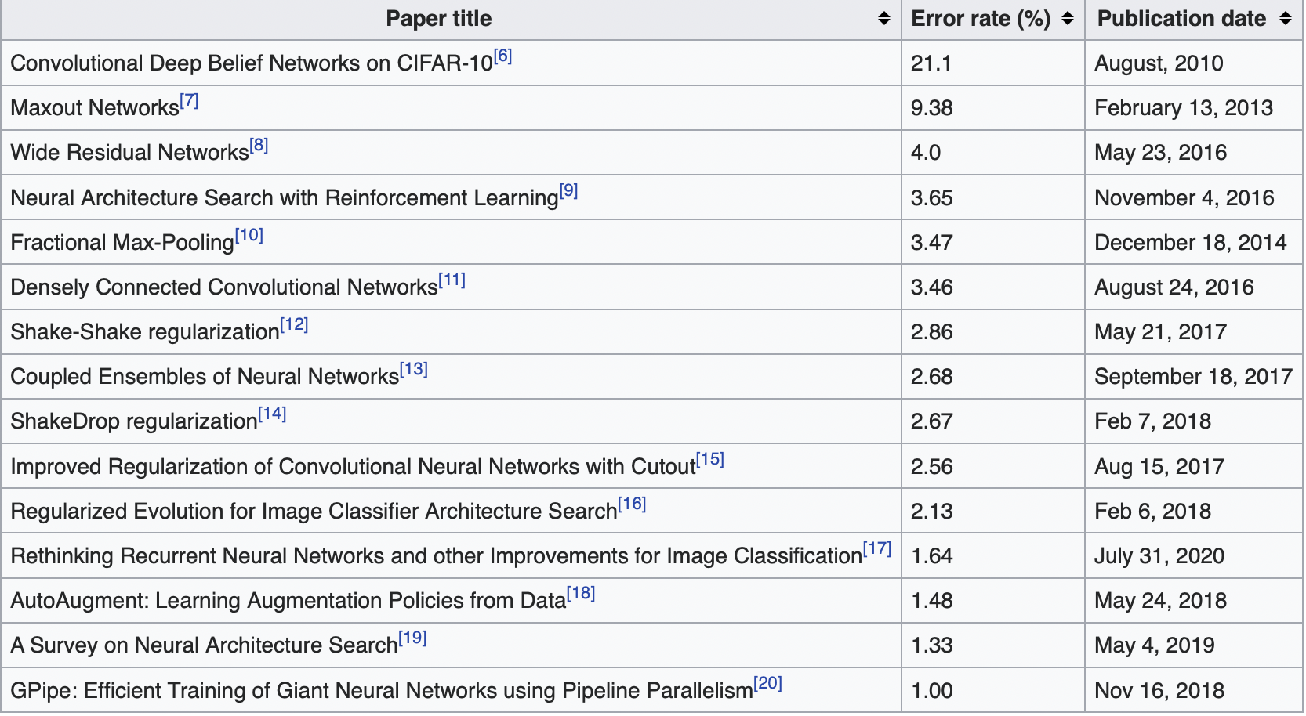
Literature Review:
Papers alongside their success rate for image classification on Cifar-10 sets [1]

Slide 11
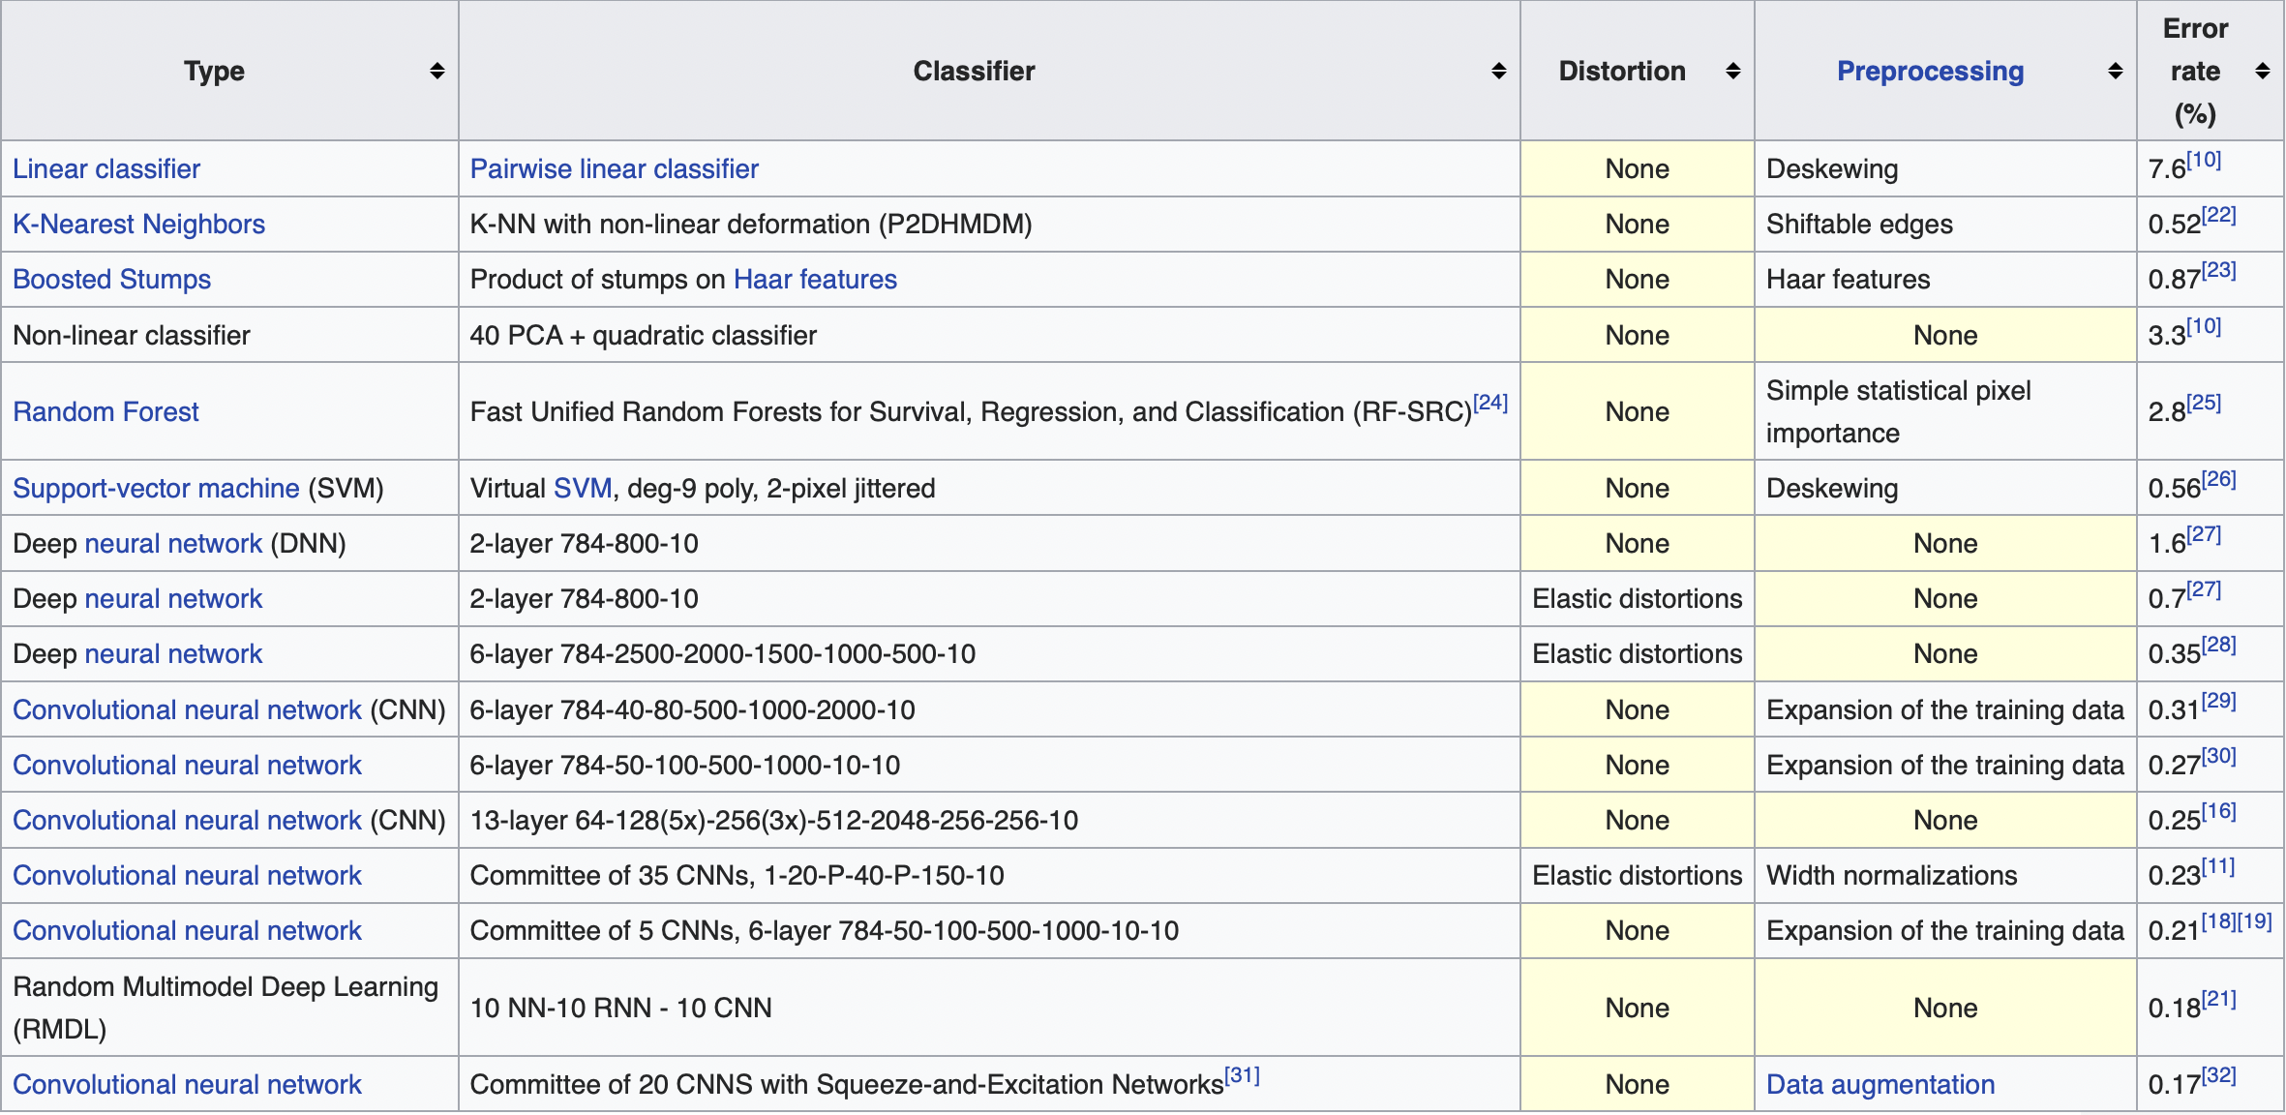
MNIST:
Various Papers with their classification success on MNIST [2]

Slide 12
Ways of Adversarial Attack :
Poisoning Attacks: The attacker influences the training data or its labels to cause the model to underperform during deployment. Hence, Poisoning is essentially adversarial contamination of training data.[2]
Evasion Attacks: Evasion attacks are the most prevalent and most researched types of attacks. The attacker manipulates the data during deployment to deceive previously trained classifiers. Since they are performed during the deployment phase, they are the most practical types of attacks and the most used attacks on intrusion and malware scenarios.[3]

Slide 13
Model Extraction
Model stealing or model extraction involves an attacker probing a black box machine learning system in order to either reconstruct the model or extract the data it was trained on.
This is especially significant when either the training data or the model itself is sensitive and confidential.
Model extraction attacks can be used, for instance, to steal a stock market prediction model, which the adversary could use for their own financial benefit.

Slide 14
Approach :
Fast Gradient Sign method (FGSM)
A simple and fast gradient-based method is used to generate adversarial examples to minimize the maximum amount of perturbation added to any pixel of the image to cause misclassification.
Advantages: Comparably efficient computing times.
Disadvantages: Perturbations are added to every feature.

Slide 15
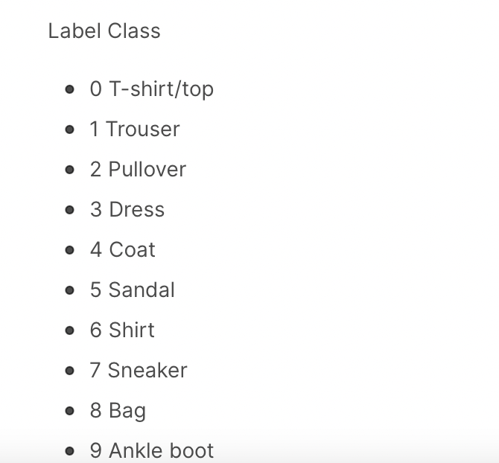
The images are 28x28 NumPy arrays, with pixel values ranging from 0 to 255. The labels are an array of integers, ranging from 0 to 9. These correspond to the class of clothing the image represents:

Slide 16
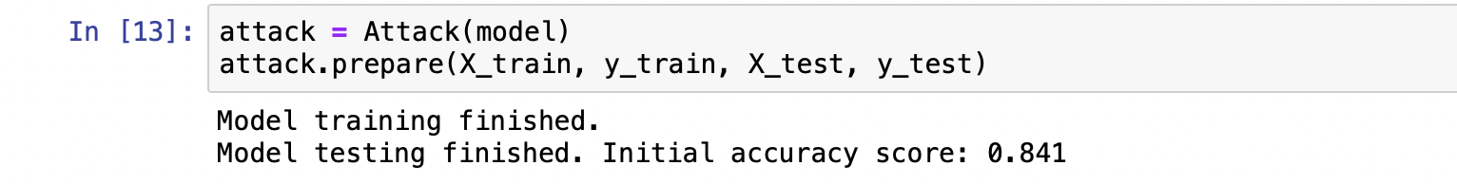
We use Multi-class Logistic Regression

Slide 17
In multiclass logistic regression the probability that the model outputs 𝑦𝑛 yn of 𝑁N inputs 𝑥𝑛xn matches their targets 𝑡𝑛tn is given by:
𝑝(𝑡|𝑦(𝑥,𝑤))=∏𝑛=1𝑁∏𝑘=1𝐾𝑦𝑡𝑛,𝑘𝑛,𝑘p(t|y(x,w)) =∏n=1N∏k=1Kyn,ktn,k
We assumed that inputs and class memberships are independent and identically distributed. The target 𝑡𝑛/tn of one input 𝑥𝑛/xn is a vector with K elements following one-hot-encoding (the true label class is 1, all others are 0).
Maximizing the probability of matches above is also called the maximum likelihood approach.
Each class in a multiclass logistic regression has its own weight vector and inputs are passed with weights through the soft-max function to obtain the model output:
𝑦𝑛,𝑘=exp(𝑤𝑇𝑘𝑥𝑛) ∑𝐾𝑐=1exp(𝑤𝑇𝑐𝑥𝑛)yn,k=ex(wkTxn)∑c=1 Kexp⁡(wcTxn)

Slide 18
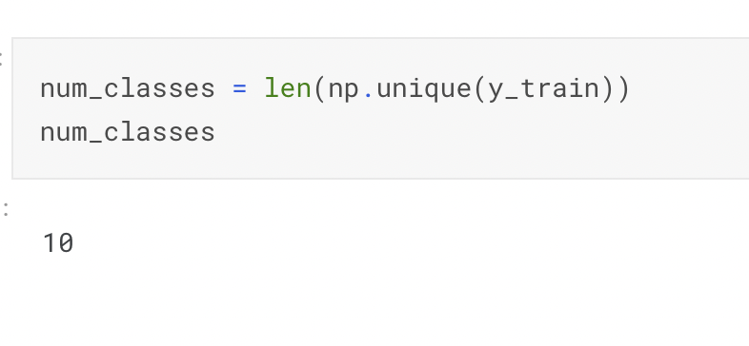
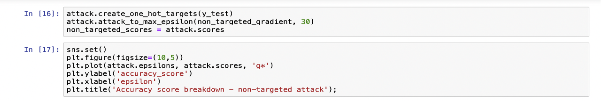
We check if we have as much weight vectors as classes:

Slide 19
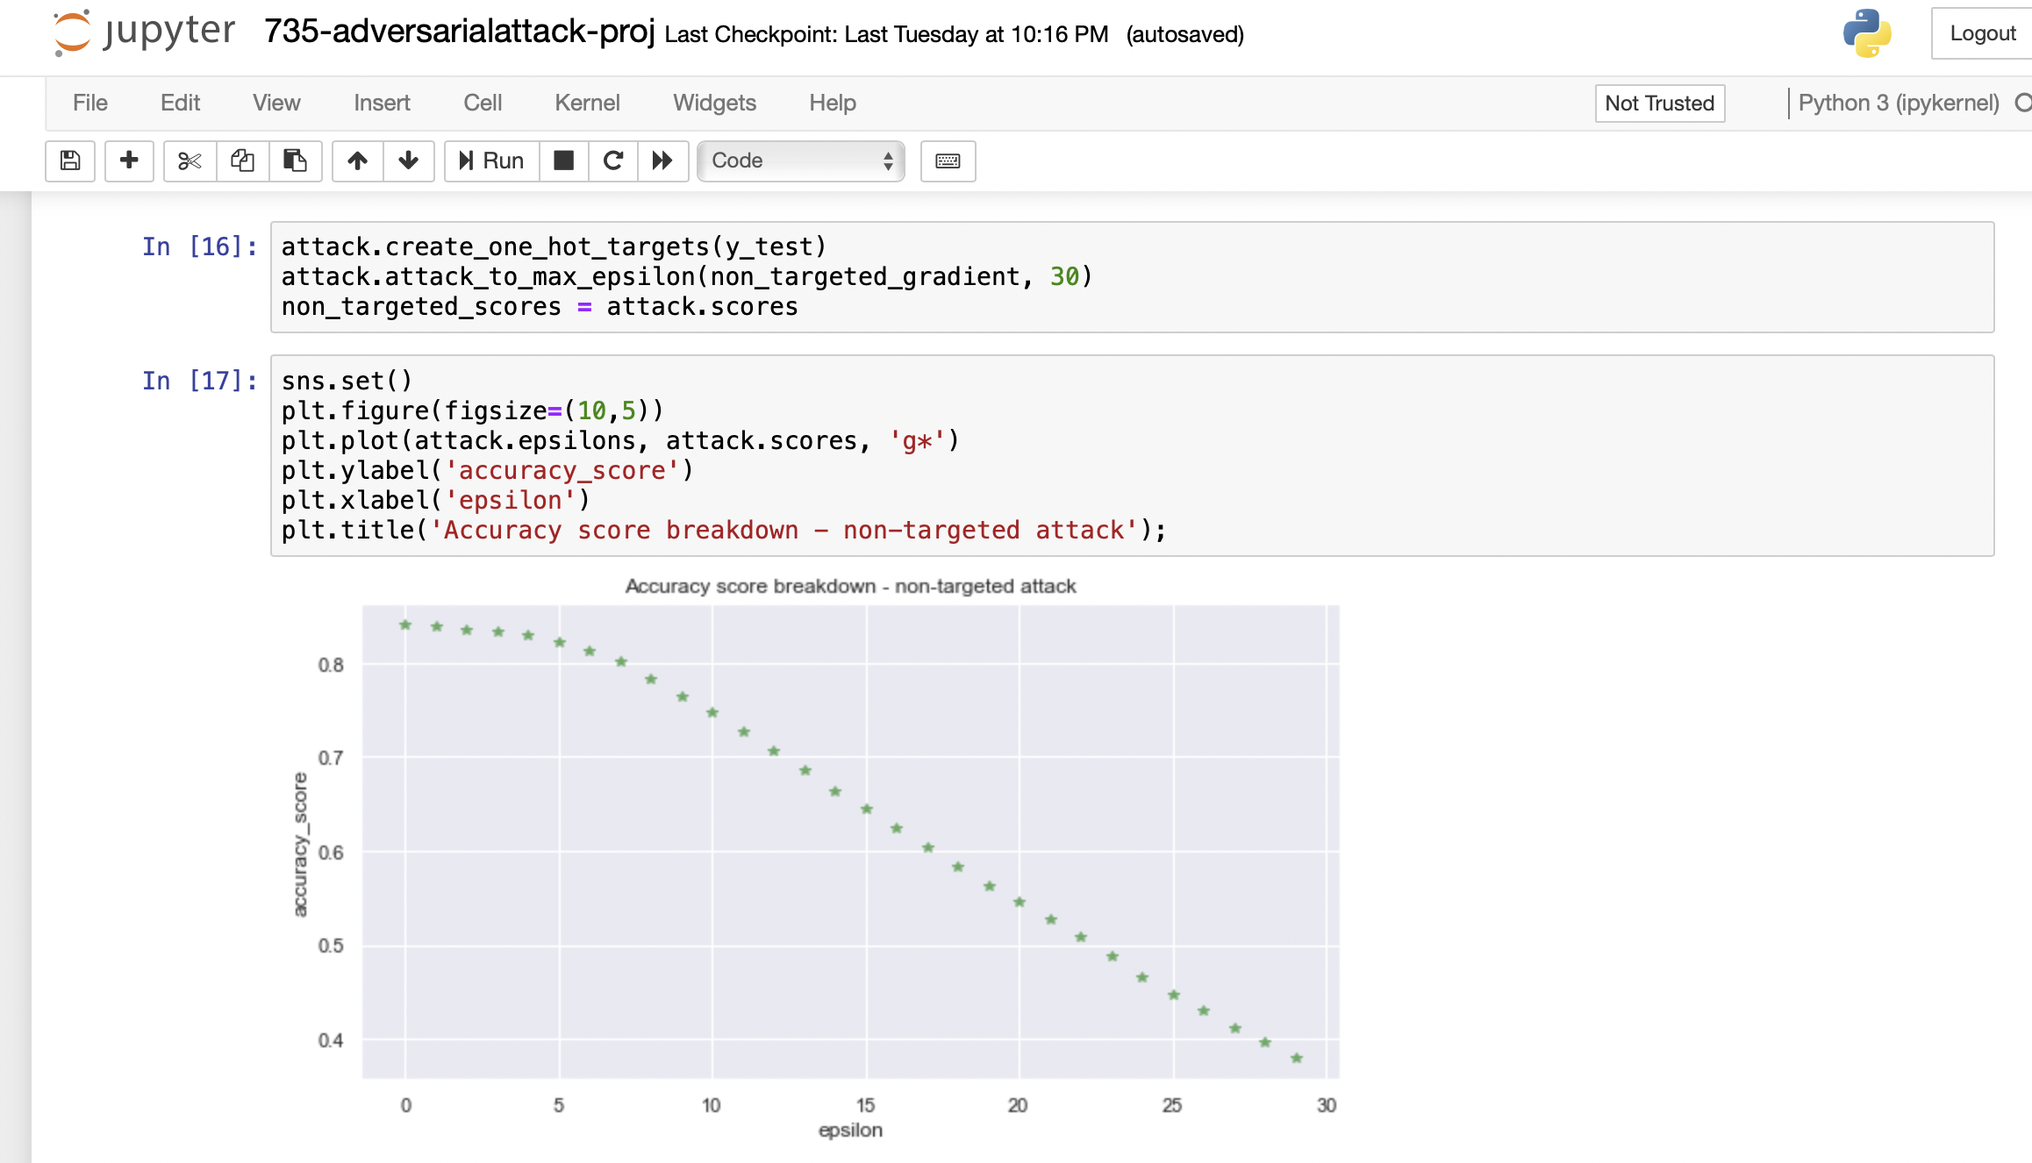
Results:

Slide 20
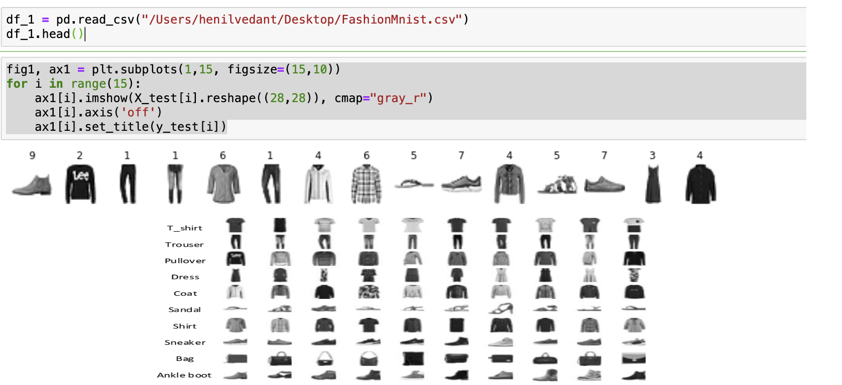
Experimental Setup:
Dataset used: FMNIST (Fashion Mnist).

Slide 21
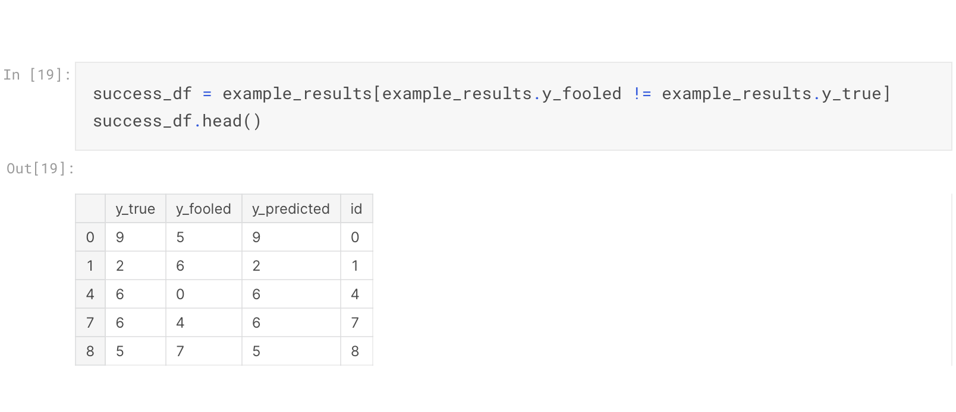

Slide 22
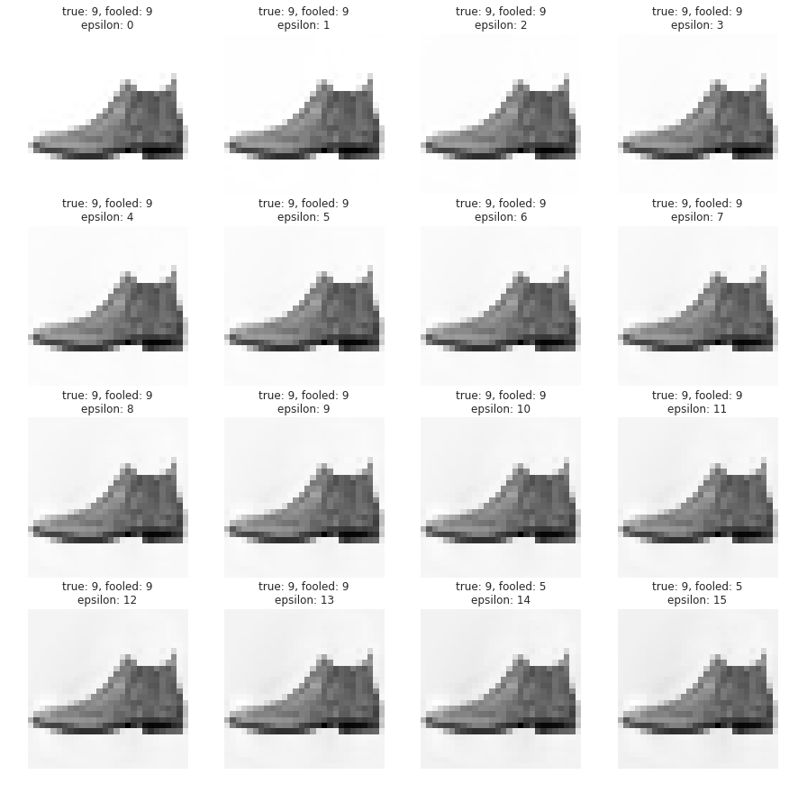

Slide 23
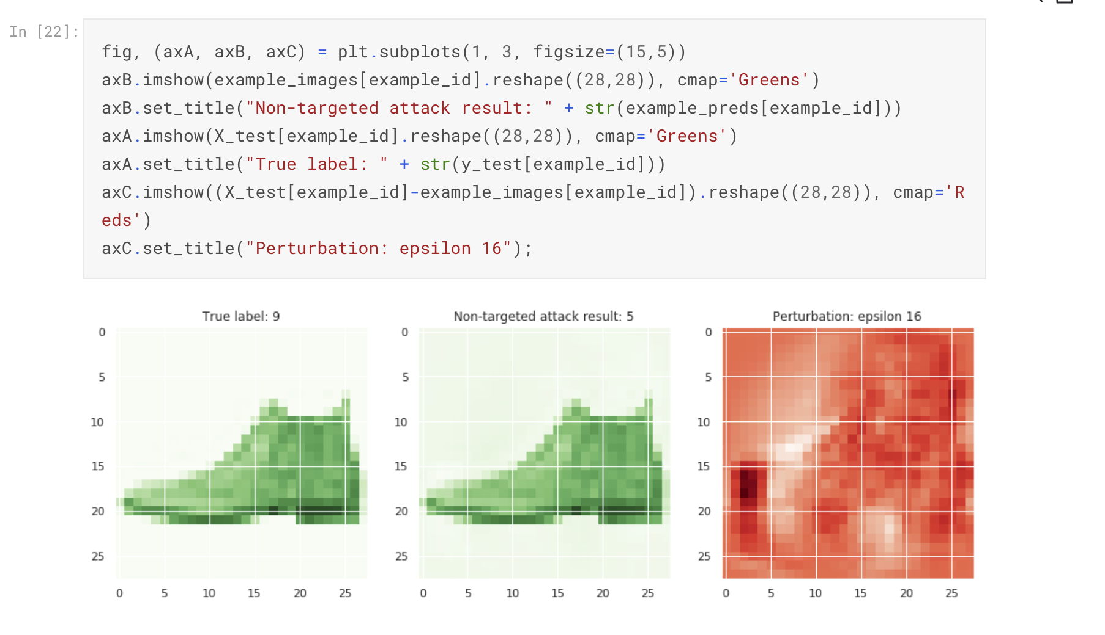
Results

Slide 24
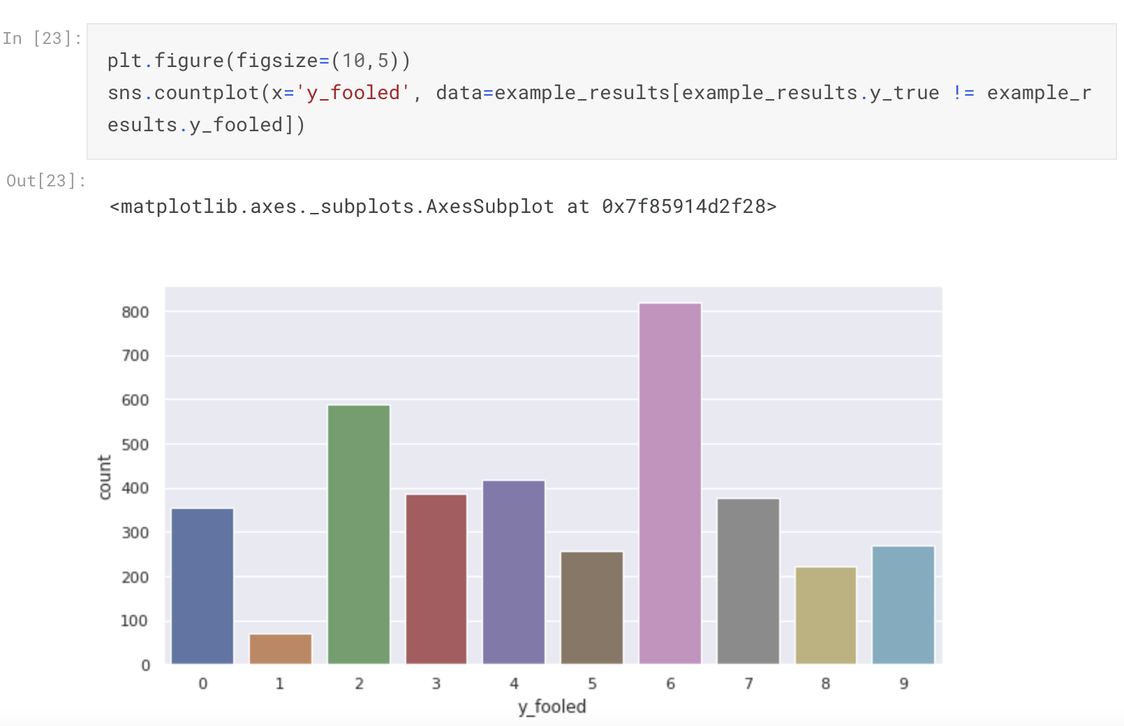
Results

Slide 25
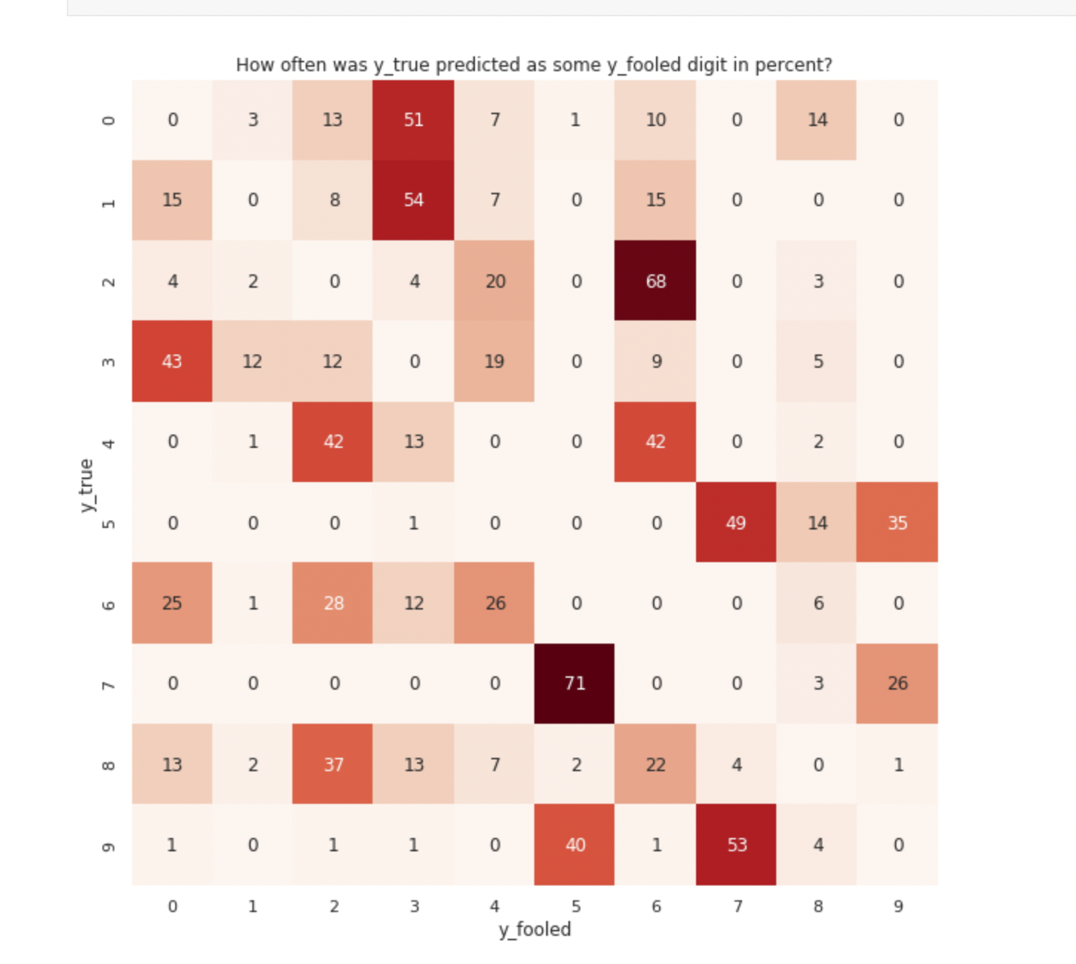
We found out that each digit has its natural fooling target.

Slide 26
Inference & Comments :
In the previous slide we see how certain characters/numbers (features) have a more malicious effect compared to other adversarial samples.
To further illustrate this point we prepare our samples and divide them into natural and non-natural fooling targets.

Slide 27
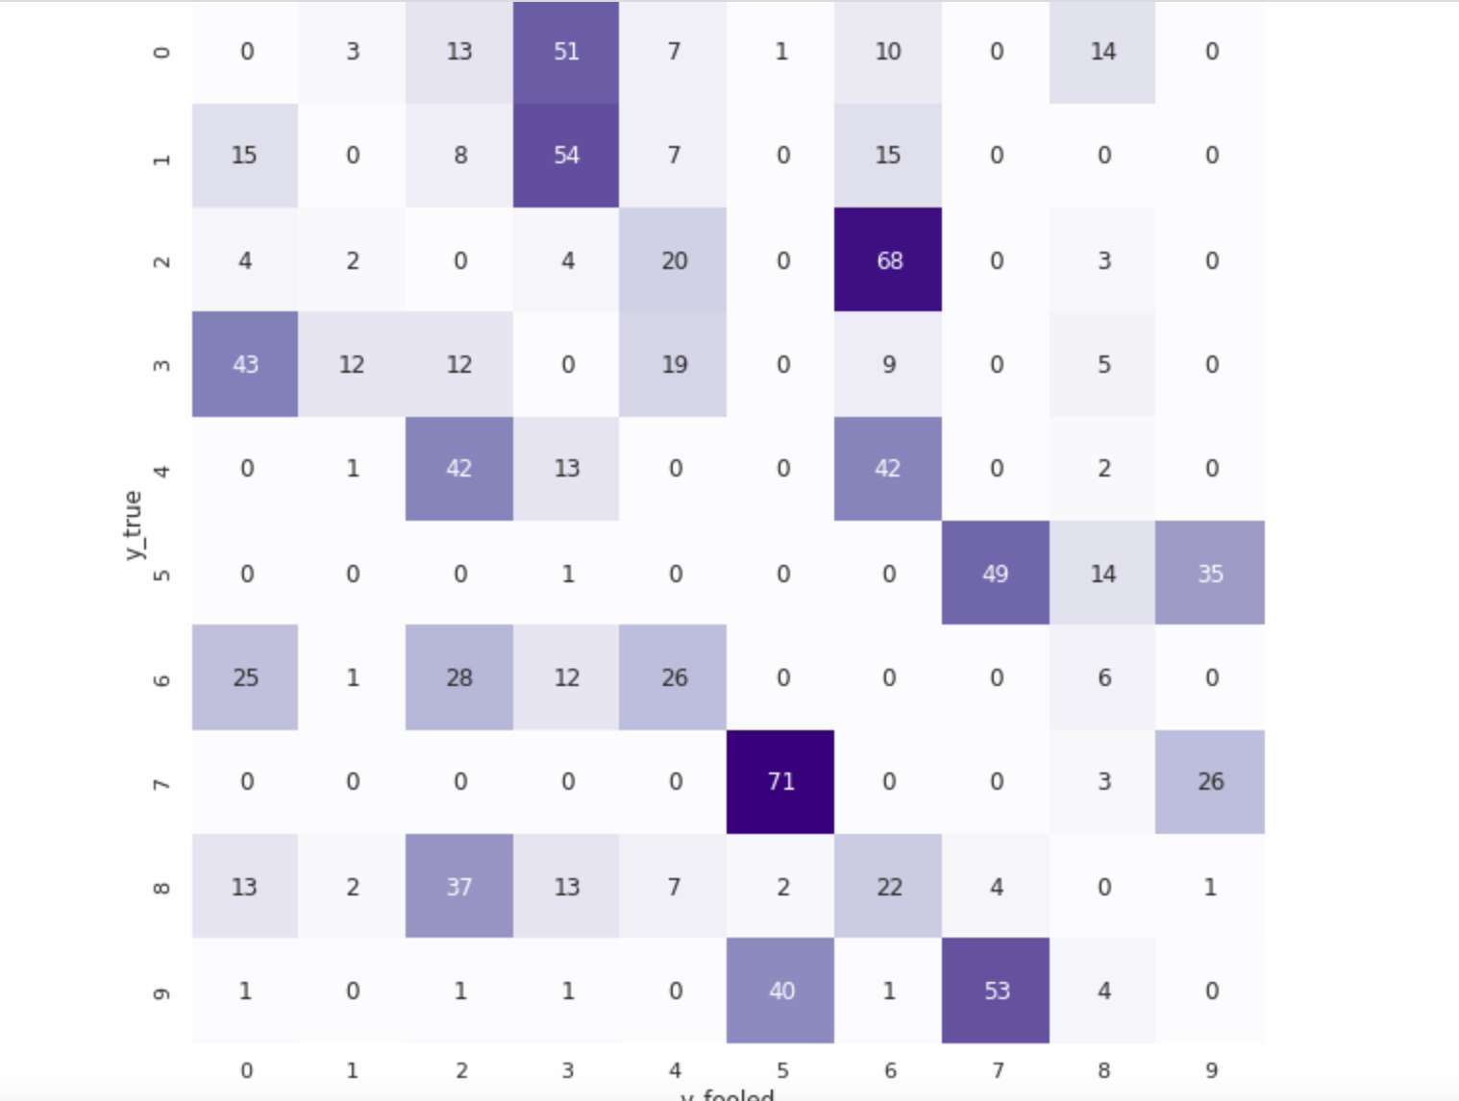

Slide 28
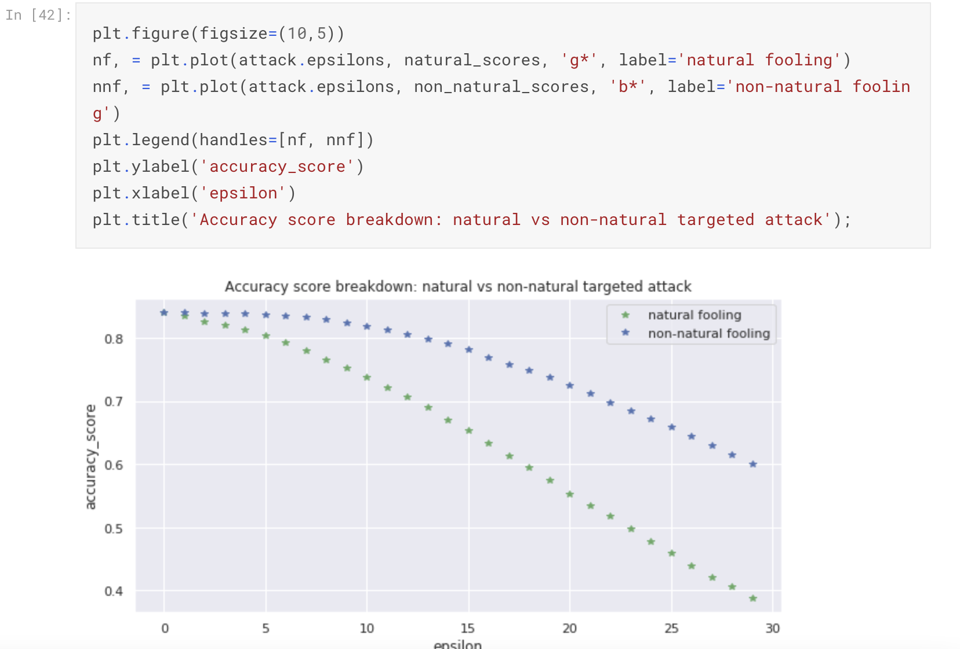

Slide 29
COMMENTS:
The goal of above short experiment was to demonstrate and illustrate how the image is classified and based on its perturbation, targeting the right perturbation at the Epsilon value helps us greatly in making the system fail in its classification.
Jacobian distillation is one of the approach that can intuitively provide defense against laplace and gaussian noise for adversarial samples.

Slide 30
Fooling takes place in regions where the model fails to draw good decision boundaries which of course depends on the model architecture/flexibility but on the input data quality and preprocessing as well.
Due to the fact that some inputs are closer to each other in meanings of decision boundaries, there exist natural and non-natural fooling targets.

Slide 31
OBSERVATION:
With the attack proposed and implemented, when we target 1 image sample to understand our attack and we can see that adding random noise is not enough.
The noise added has to be a carefully calculated mathematical gradient function which we have to add at appropriate instances/perturbation to make our attack stronger.

Slide 32
Above property of ML systems and their implicit nature means that we can make the system learn better at each perturbation and make sure that the natural attacks are not overfit in the curve and that the distances between the data points or a summation of all data points will be such that their average score will always be the same net result.
Making system learn better on decision boundaries intuitively seems a good strategy as it would give us natural defense against our adversary.

Slide 33
FUTURE WORK:
Jacobian-based Saliency Map Attack (JSMA):
Unlike FGSM, the method uses feature selection to minimize the number of features modified while causing misclassification. Flat perturbations are added to features iteratively according to saliency value by decreasing order.
Generative Adversarial Networks (GAN).

Slide 34
References:
1- Adversarial Attacks and Defences: A Survey - Anirban Chakraborty, Manaar Alam, Vishal Dey, Anupam Chattopadhyay, Debdeep Mukhopadhyay, https://arxiv.org/abs/1810.00069.
2- Practical Black-Box Attacks against Machine Learning- Nicolas Papernot, Patrick McDaniel, Ian Goodfellow, Somesh Jha, Z. Berkay Celik, Ananthram Swami, https://arxiv.org/abs/1602.02697.
3- Towards Black-box Attacks on Deep Learning Apps, Hongchen Cao, Shuai Li, Yuming Zhou, Ming Fan, Xuejiao Zhao, Yutian Tang, https://arxiv.org/abs/2107.12732.
4- Adverserial Machine Learning - https://en.wikipedia.org/wiki/Adversarial_machine_learning.
5- How Adverserial Examples work - https://wiki.davidl.me/view/Adversarial_Examples.
6- NIPS Completion Track- Google adversarial attack open challenge Kaggle dataset/F-MNIST https://nips.cc/Conferences/2017/CompetitionTrack.
7- Generative adversarial network, https://en.wikipedia.org/wiki/Generative_adversarial_network.
8- Black-box Adversarial Sample Generation Based on Differential Evolution, https://arxiv.org/abs/2007.15310.

